Slide 1

Qualification Alignment for Postdoc Research
Focusing on Aggregate Exposure Pathway (AEP)
A component of Source to Outcome Pathway (STOP)
Raju Rimal

Slide 2
Outline
My background
Aggregate Exposure Pathway
Data integration, analysis and visualization
Possible contribution to the STOP application
Publication and dissemination
Notes:
In this presentation, I will
Discussion some background on me and my skillset that I gather over time
My brief understanding of adverse outcome pathway (AOP) and aggregate exposure pathway (AEP)
Where I can contribute to the project in different stages of data pipeline
How I can contribute to the STOP application development, and
Finally, I would share relevant my academic works
I will also open to have discussion in between if you prefer that way.

Slide 3
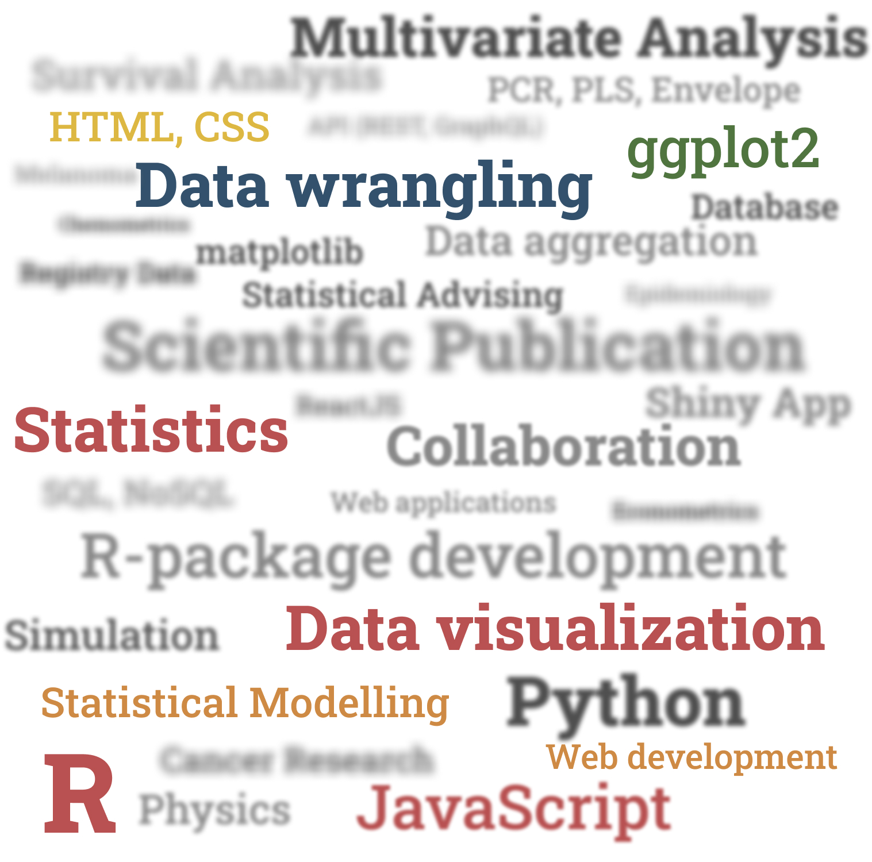
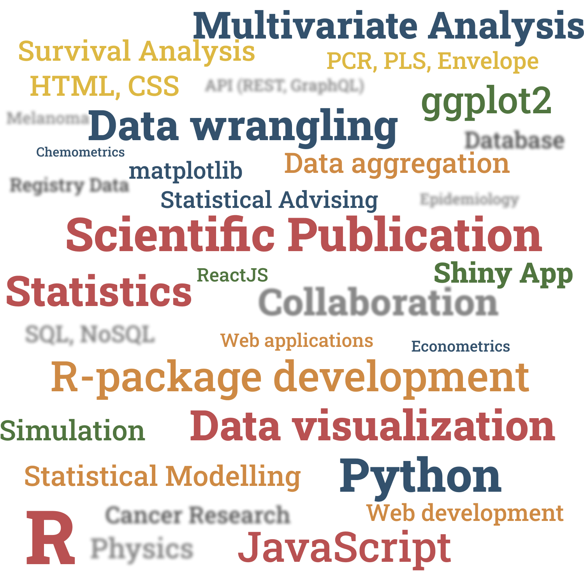
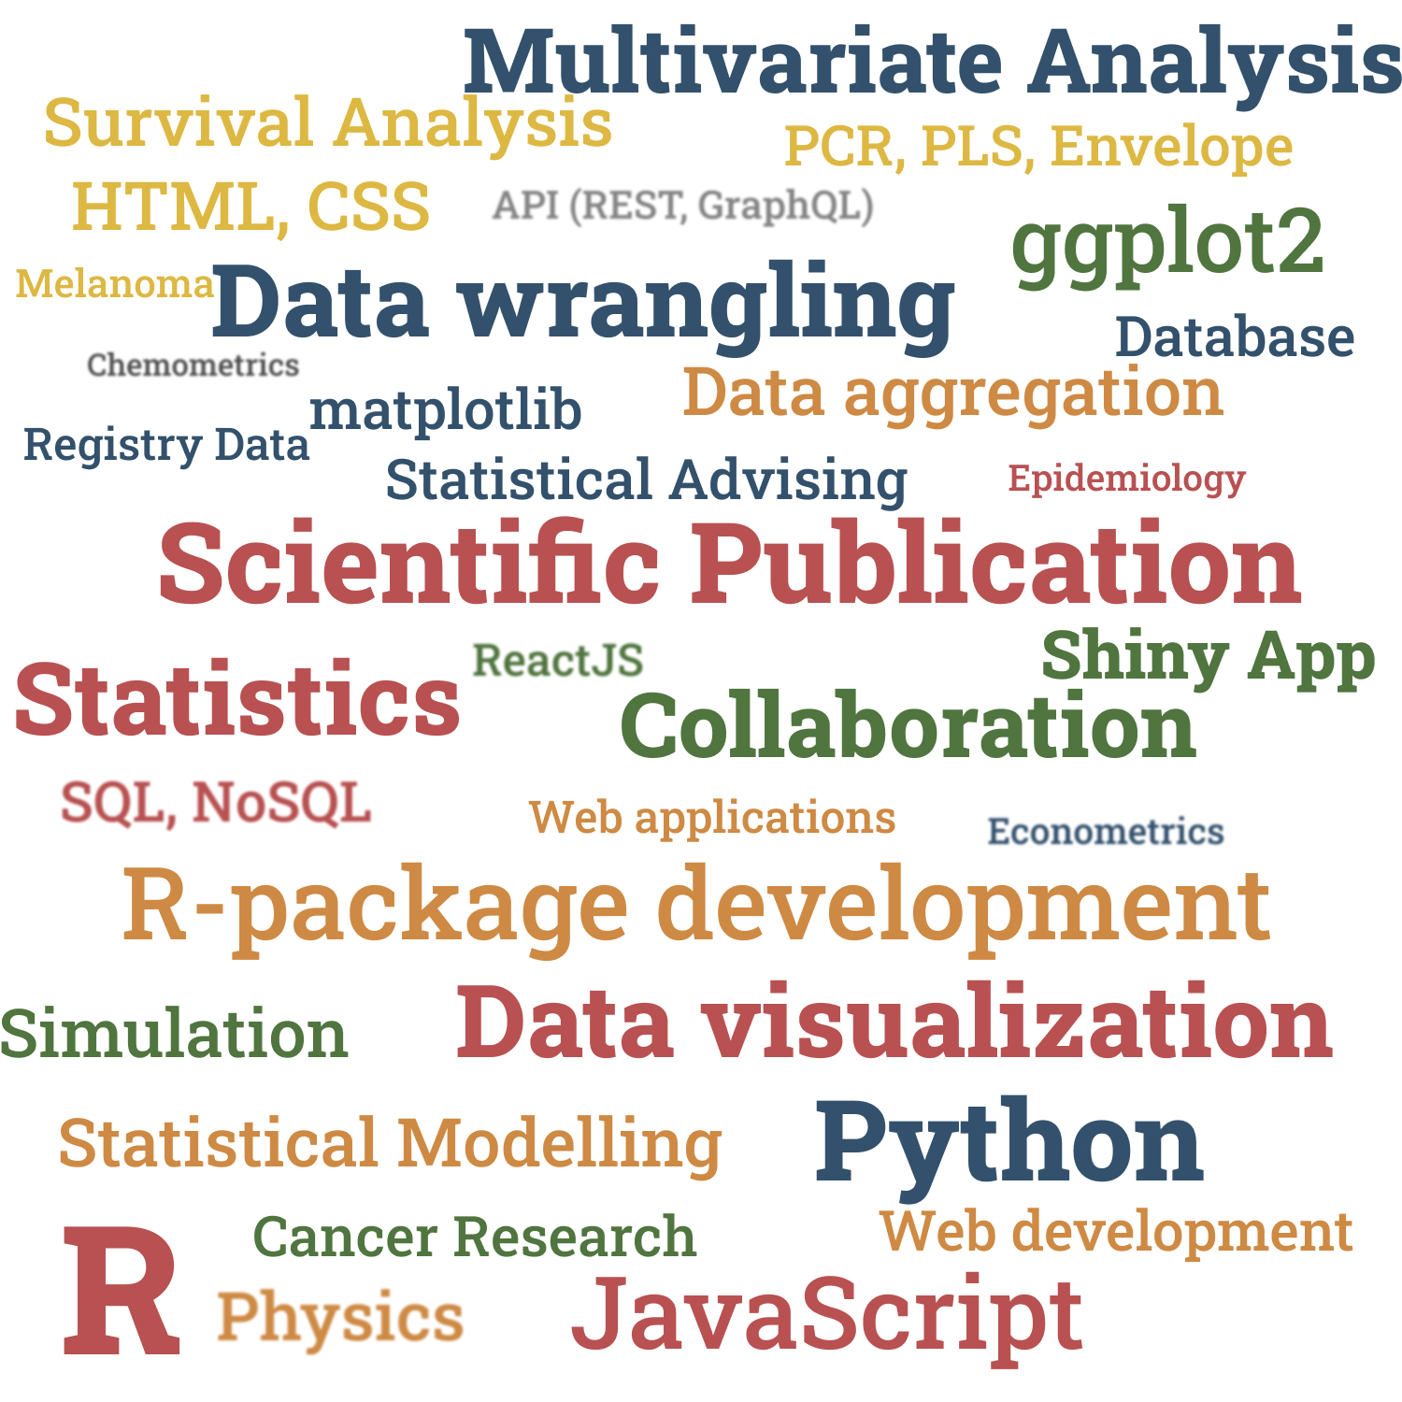
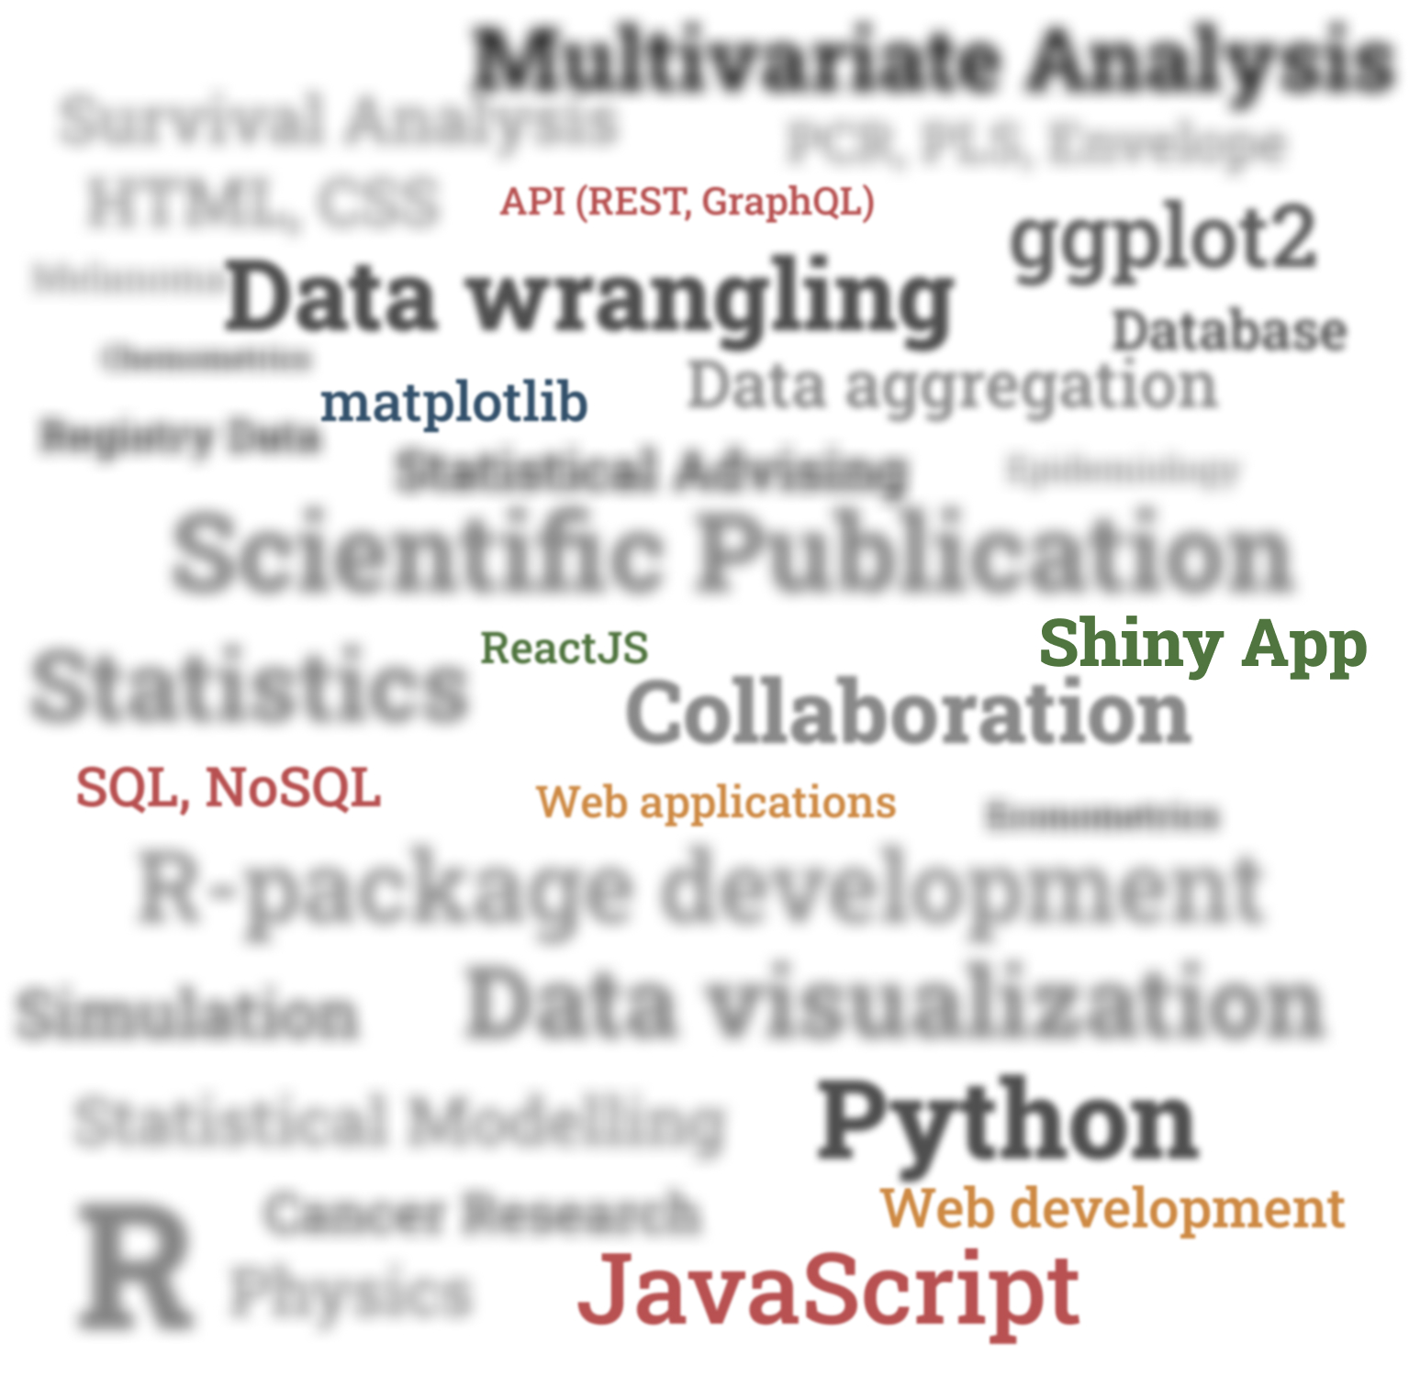
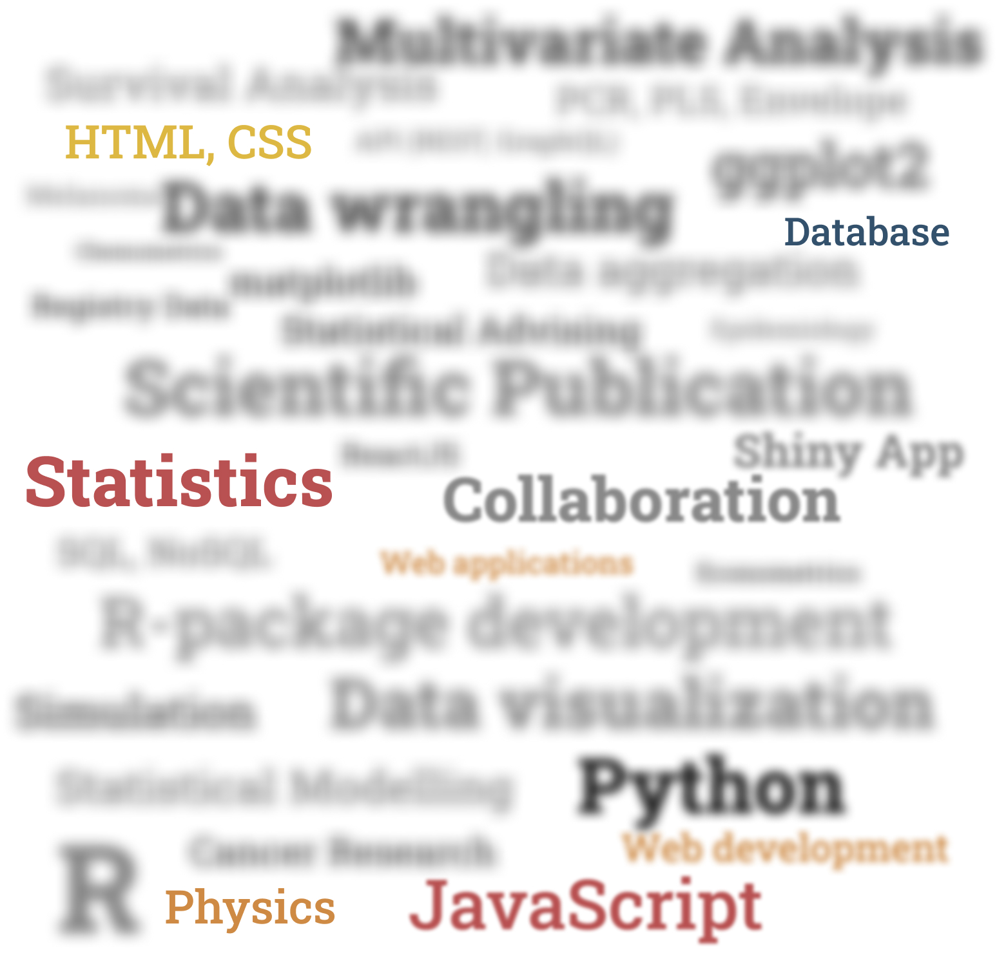
My background
Education
Bachelor
Masters
PhD
Experience
Consultant
Postdoc
Interest
Notes:
Bachelor
I started learning statistics from bachelor. Initially I wanted to learn Physics and afterwards ended up on statistics which I am happy with.
Masters
During my masters, I worked with econometrics data which have highly correlated variables and observations.
During the time, I started my journey of R and Python and Data wrangling and visualization.
I did my first masters in Nepal but it was mostly theoretical and lots of derivation of distribution and theory on probabilities etc.
During my masers at NMBU, I learned the applied side of statistics.
I learned most of the things while doing my Thesis on comparison of statistical methods using commodity and exchange rate data.
PhD/Consultant
I started my PhD to work with simulation model for simulating data from relevant component model.
My understanding on statistical model, simulation increased quite a lot.
I also developed R-package, different shiny application both as a GUI for the package and to show the results for my thesis.
Encountering problems from wide field of study during the statistical advising was both challenging and exciting but worthwhile.
I also gained skills on JavaScript, API, Database and development of web application during the consultant position after PhD.
Postdoc
My current position as Postdoc is very different from my previous work.
This is more collaborative intensive project.
I worked with survival analysis and epidemiological concept with main focus on cancer research.
I also learned Stata software on the way.
Self interest
The tools and technologies I learned are mainly out of my interest.
I believe that these skills and my educational background will help me to learn new concept quickly and directly work and contribute to the project.

Slide 4
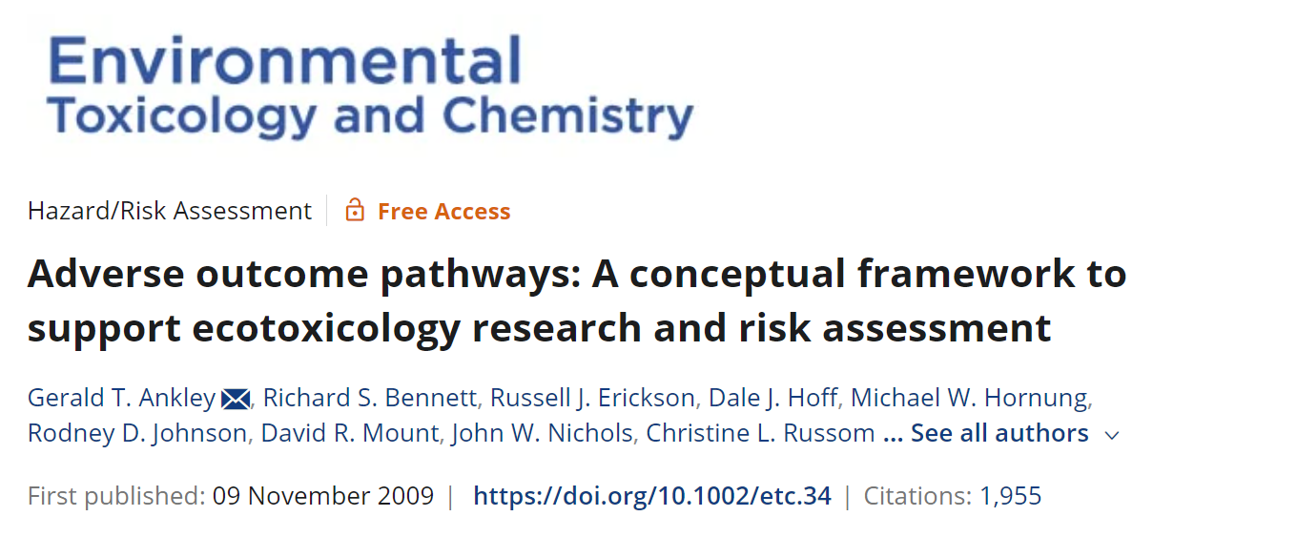
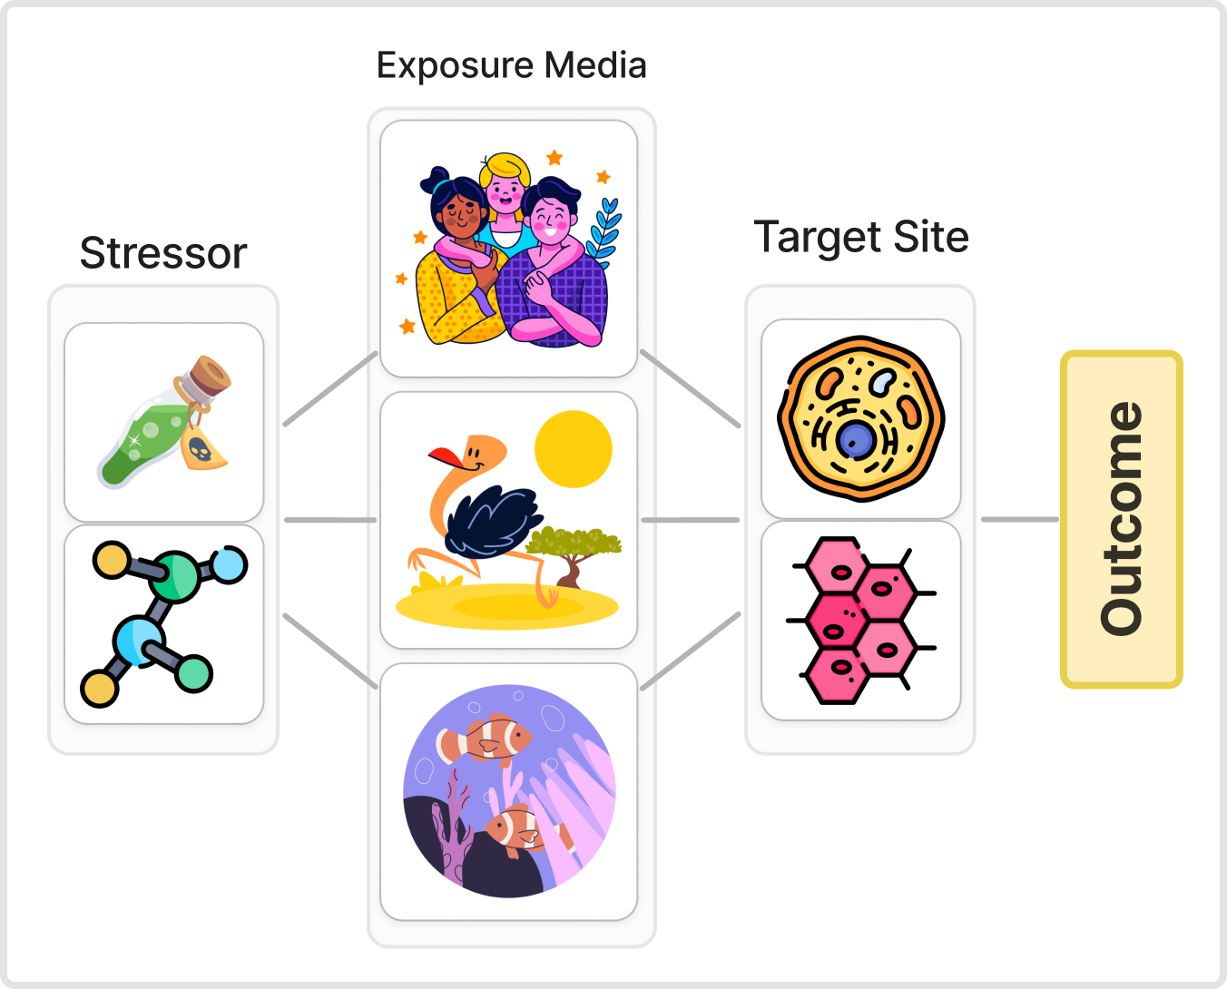
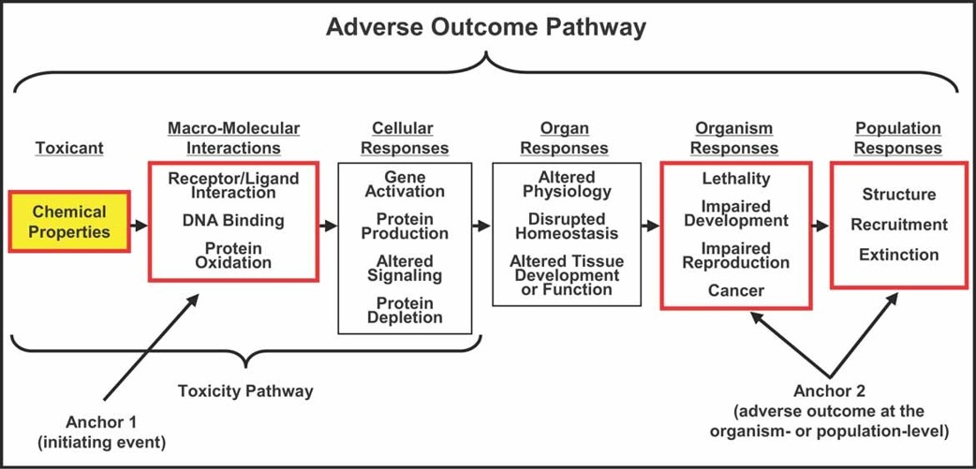
Aggregate Exposure Pathway (AEP)
Enviro Toxic and Chemistry
Volume: 29
Issue: 3
Pages: 730-741
Published: 09.11.2009
DOI: 10.1002/etc.34
Notes:
I have some basic understanding about the Aggregative Exposure Pathway (AEP) which I knew nothing before I applied for the job.
A conceptual framework to study the journey of a toxicant, after it enters a target site (tissues or cell), to adverse outcome (AOP).
In 2009, the concept was interdicted. Here we study how a cell, tissue and/or organ respond and how it ends up to adverse outcome such as cancer.
But there are so many ways the chemical/ toxicant, which we can also call stressor ends up to the target site from where it starts its journey of AOP.

Slide 5
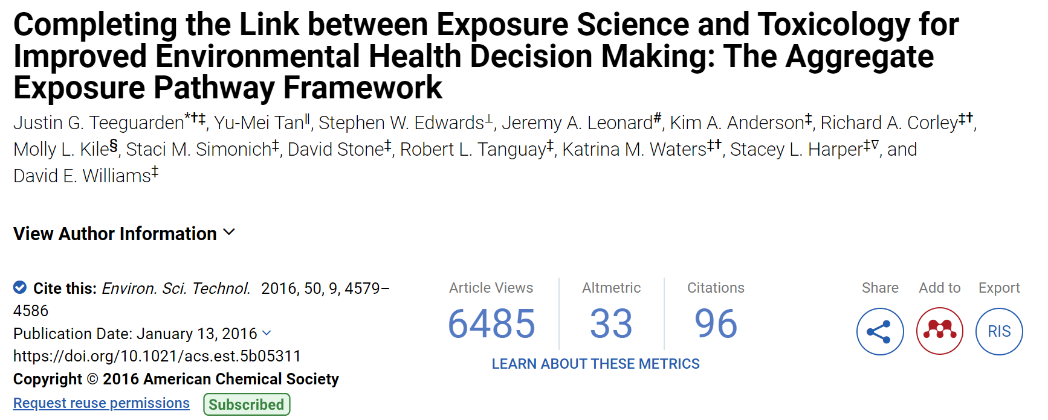
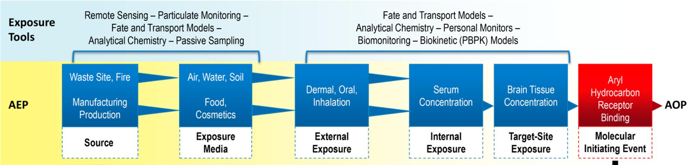
Aggregate Exposure Pathway (AEP)
Environmental Science & Technology, Volume: 50, Issue: 9, Pages: 4579-4586
Published: 03.05.2016
DOI: 10.1021/acs.est.5b05311
Notes:
In exposure pathway, we analyse the journey of a stressor from its source to the target site, i.e. before it starts its AOP journey.
For example, a toxin in a landfill site travels through different medium such as water to fish/ birds or other animals to human which eventually ends up with disease outbreak or some other chronic disease.

Slide 6
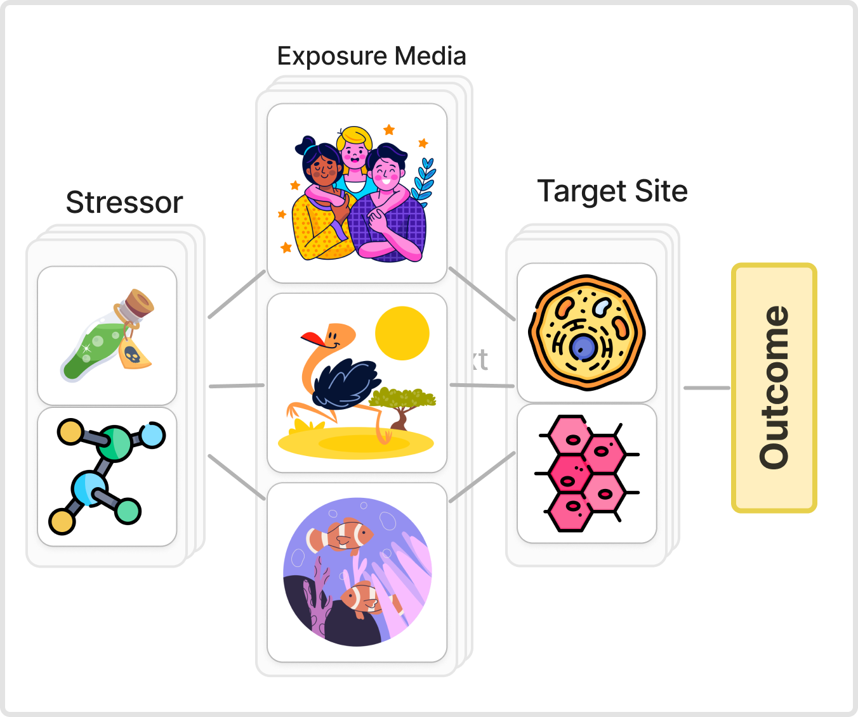
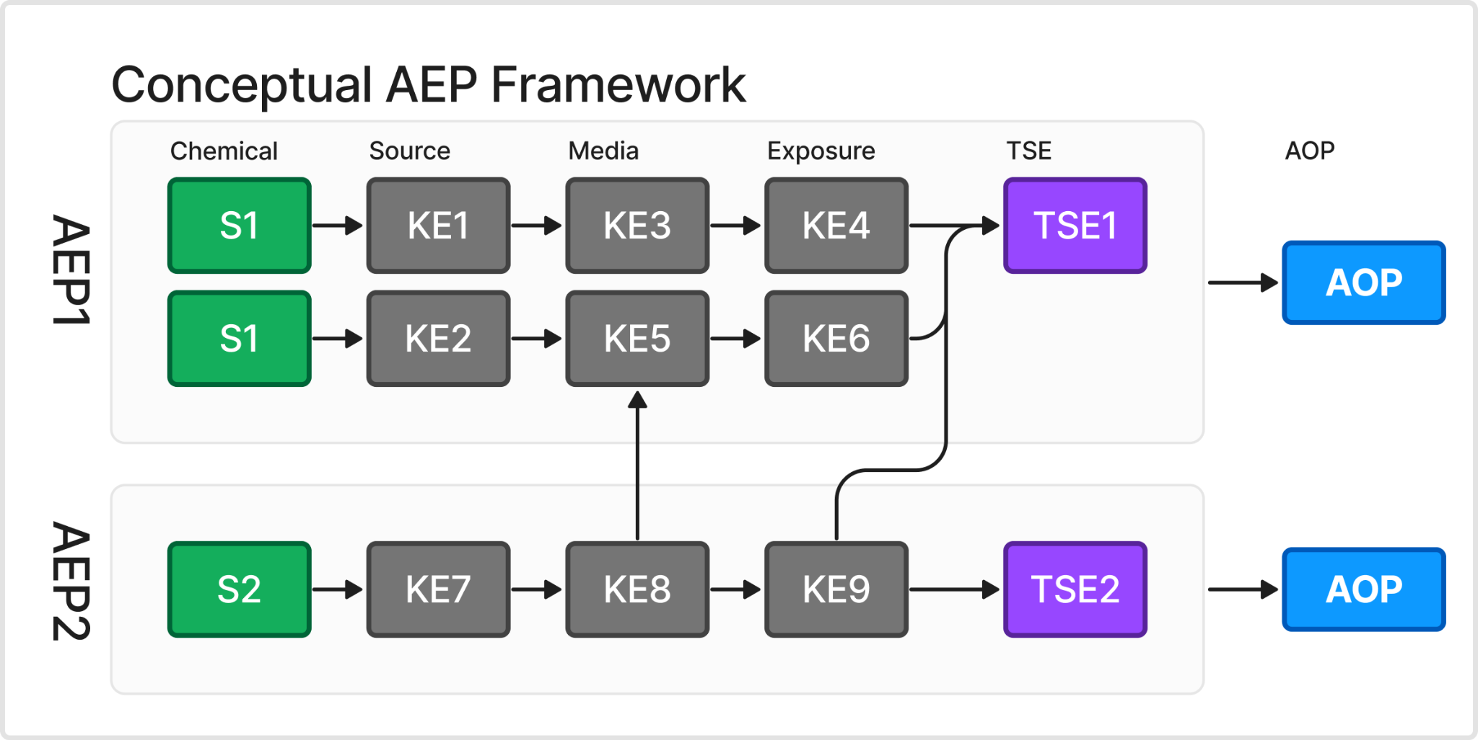
Aggregate Exposure Pathway (AEP)
Environmental Science & Technology, Volume: 50, Issue: 9, Pages: 4579-4586
Published: 03.05.2016
DOI: 10.1021/acs.est.5b05311
Notes:
But there can be several of such stressor with their own pathway to the target site.
In 2016, the aggregate exposure pathway as a framework completing the link establishing the framework to study pathway from source to the outcome.
The framework has brought together several fields of sciences such as chemometrics, epidemiology, genomics, and multivariate analysis.
This combination of fields demands for more sophisticated and aggregated data workflow/pipeline.

Slide 7
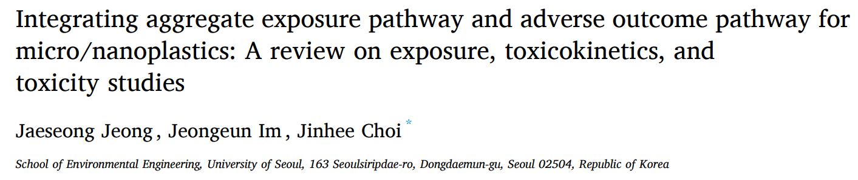
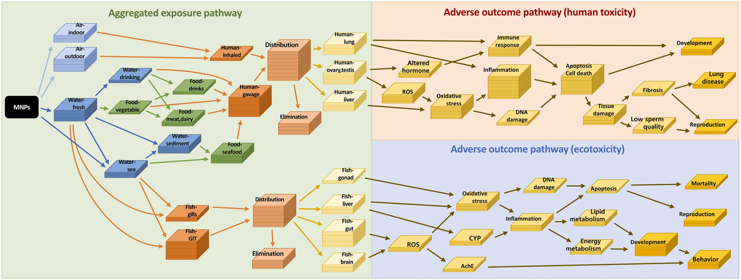

Slide 8
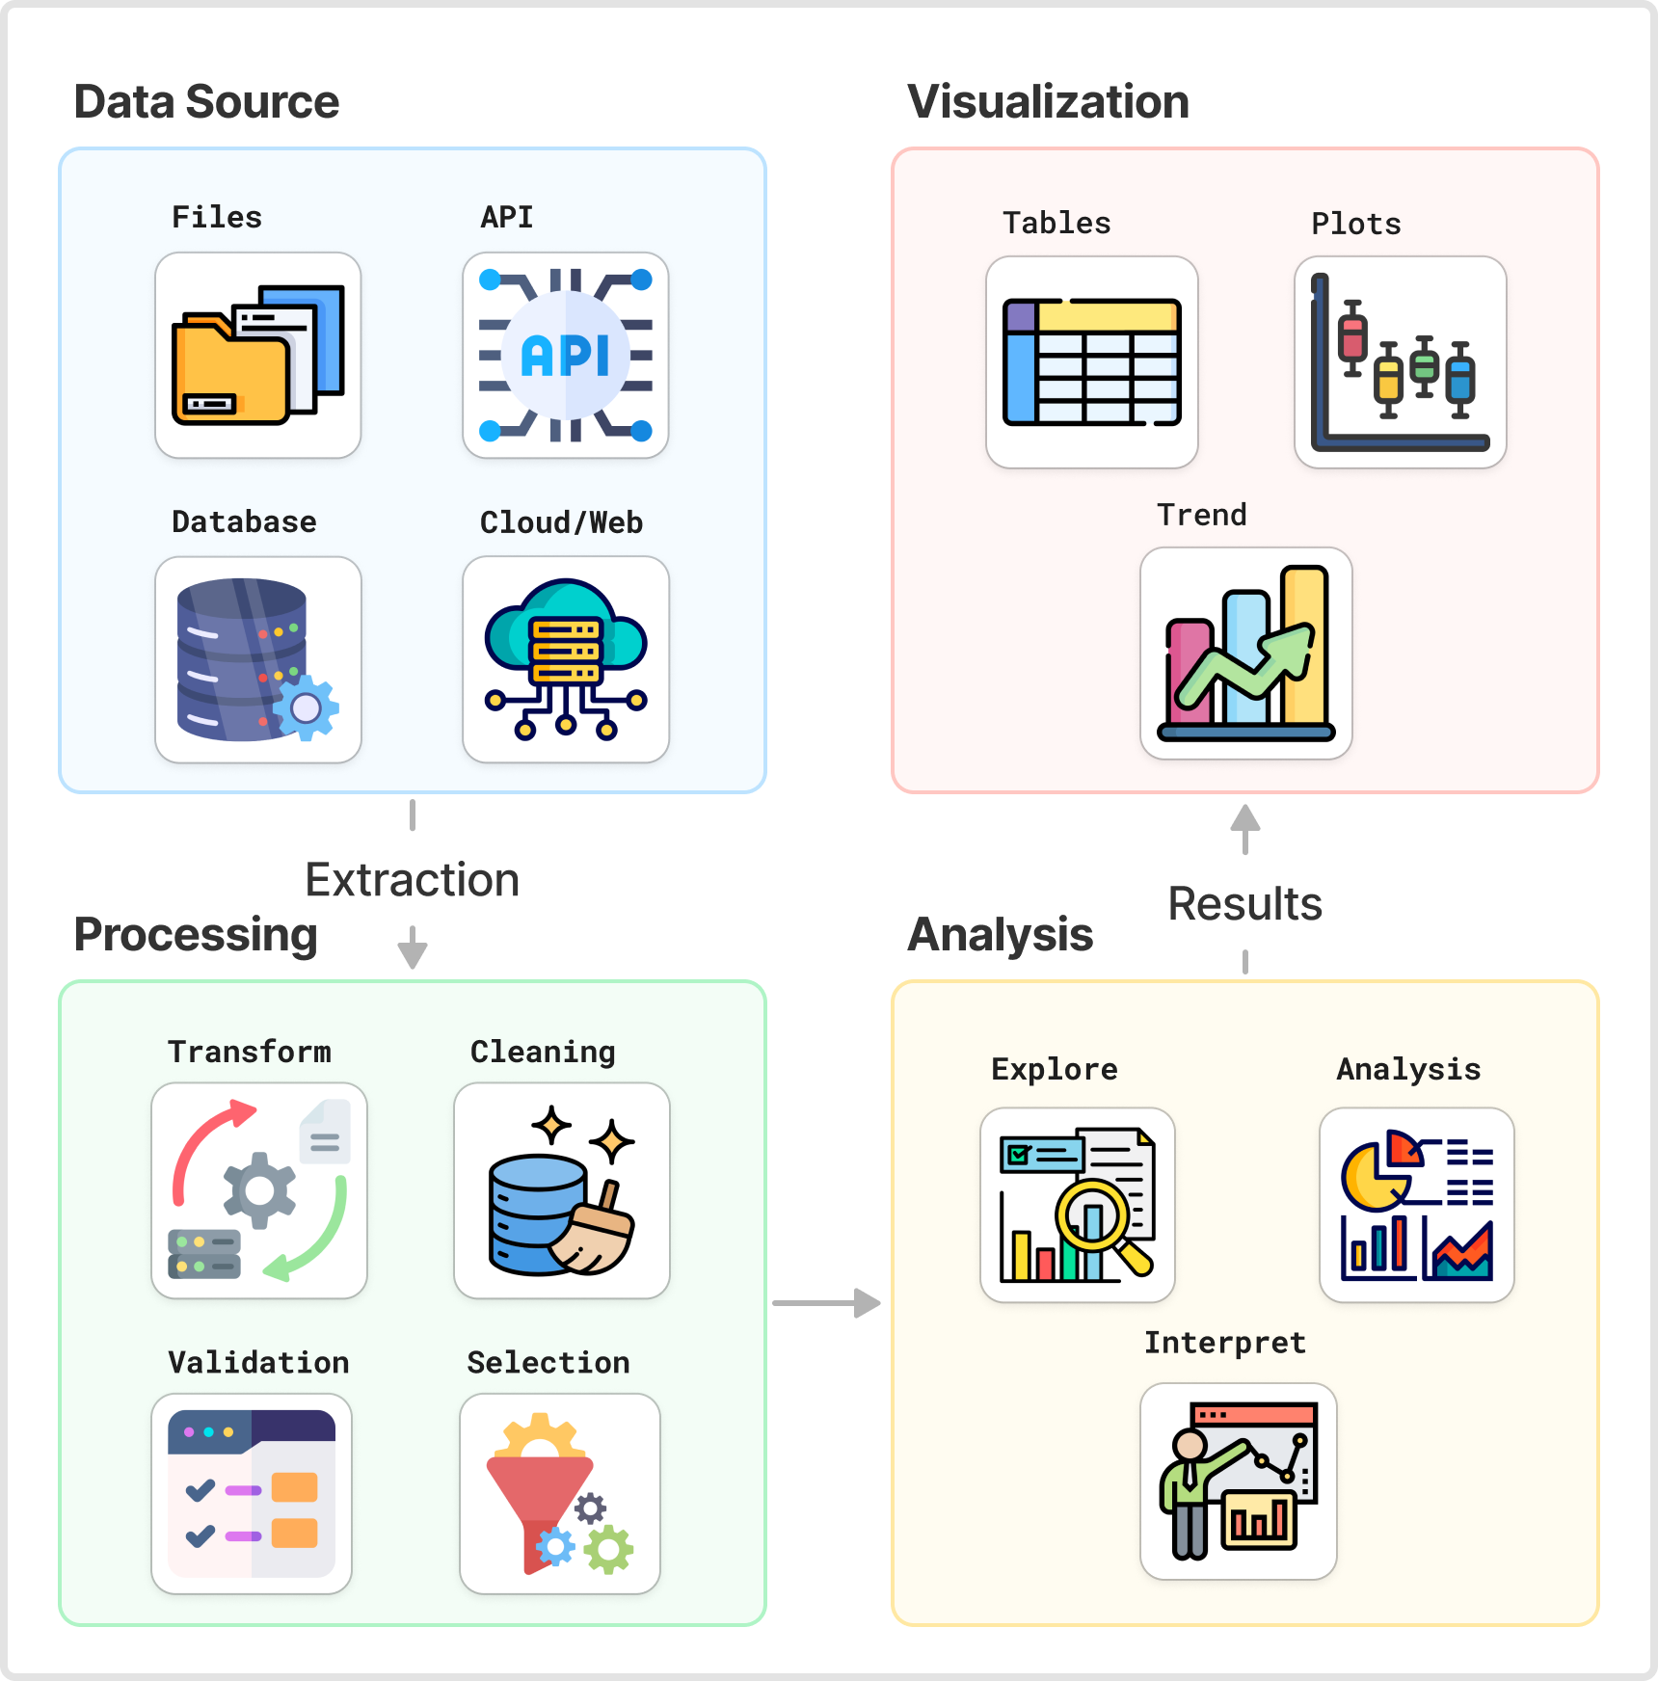
Data integration, analysis and visualization
Many data sources
Continuously updated data
Data of different properties
Integrated analysis and modelling
Customizable visualization
Need of data pipeline

Slide 9
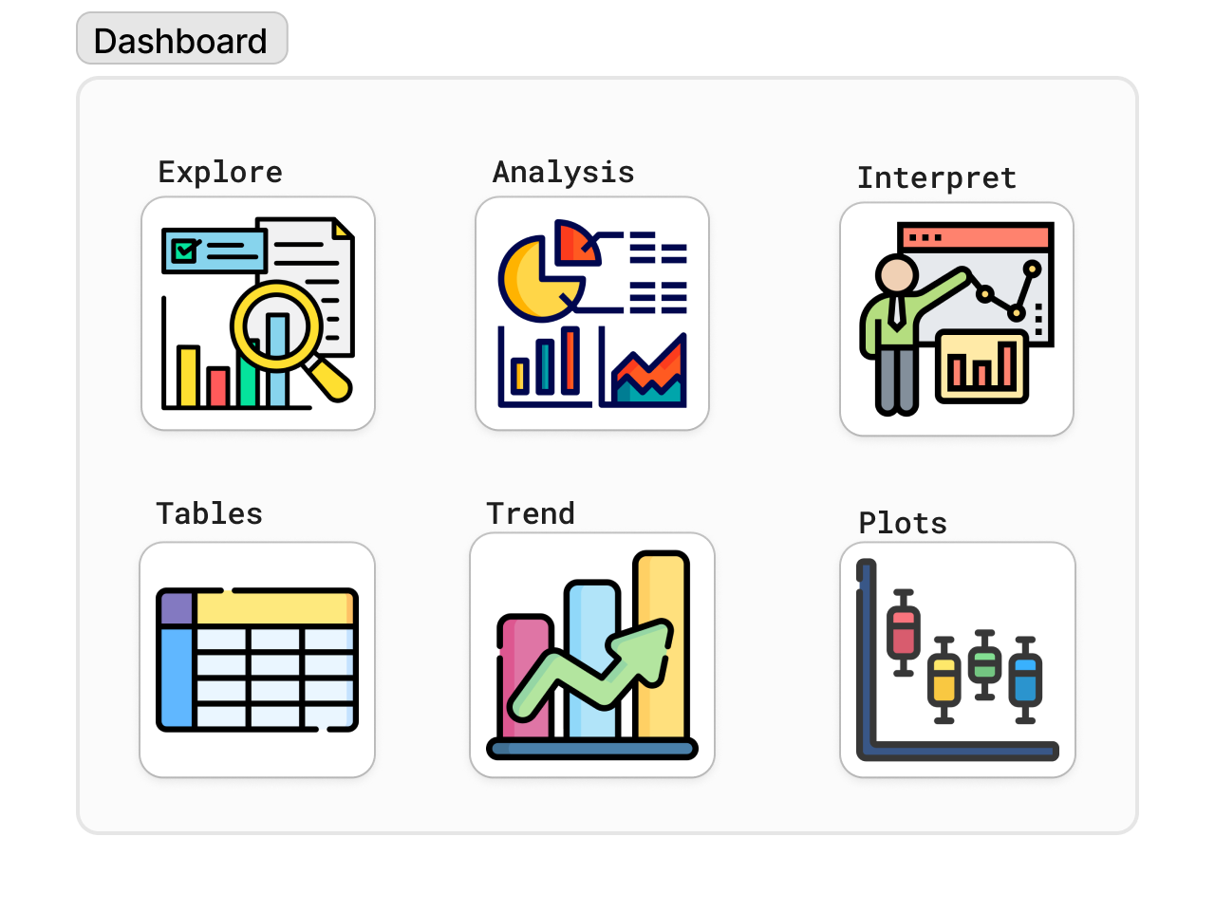
Contributing to the STOP application
Improved Graphical User Interface (GUI)
Build faster Shiny App
Interactive visualization of exposure, effect and risk predictions
Informed by better AEP and AOP

Slide 10
Aligned Scientific Experiences
Research fields and publication
Application and package development
Multivariate methods
Model selection and validation
Epidemiology
Survival analysis
Shiny application
JavaScript based web application
R and Python package
Interactive plots
Thank You

Slide 11
Thank You
NIVA (eco)toxicology postdoc interview
Raju Rimal, 2024
Notes:
Thank you very much for this opportunity.

